Slide 1


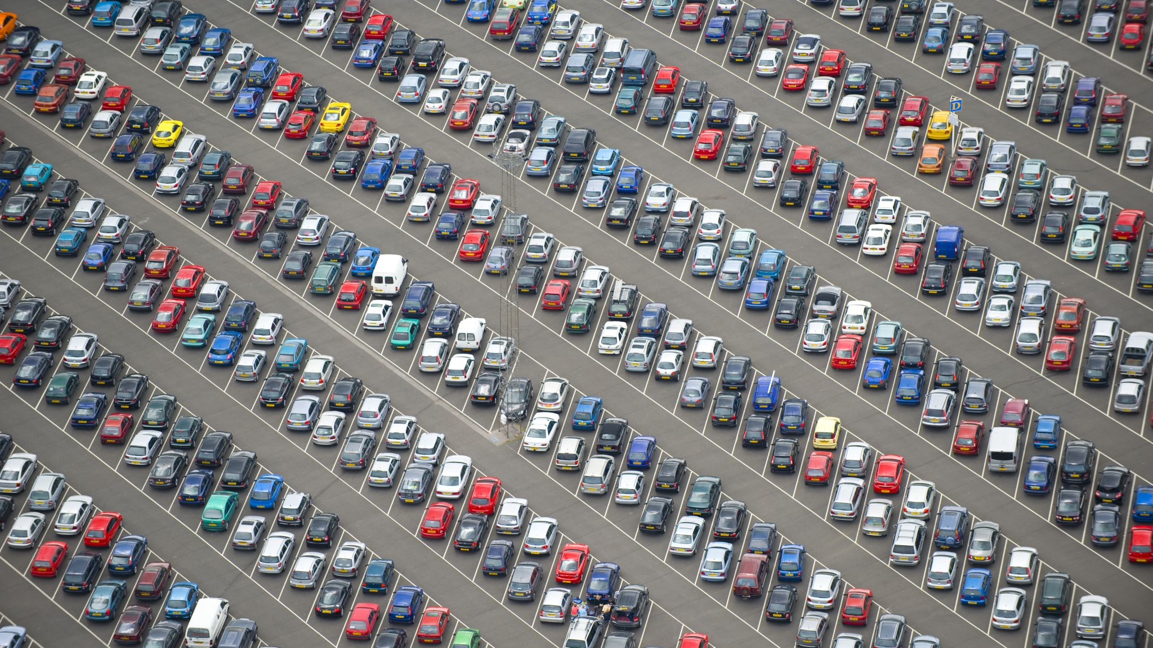

Rental Vehicles
Income based on Location and vehicle type.
Caleb Leonard
IFSM 201
October 13,2019

Slide 2
Number of cars rented in 2016

Slide 3
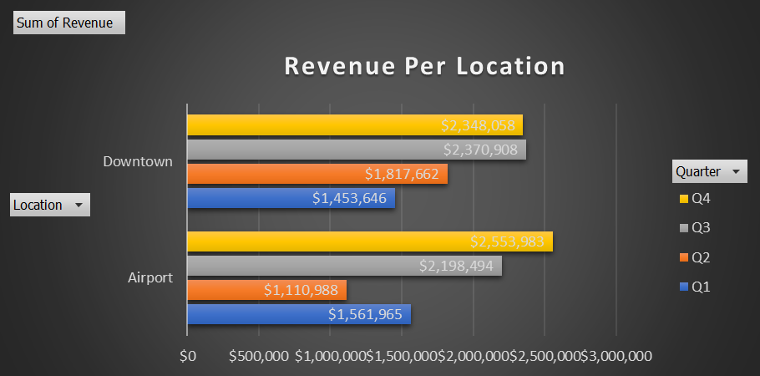
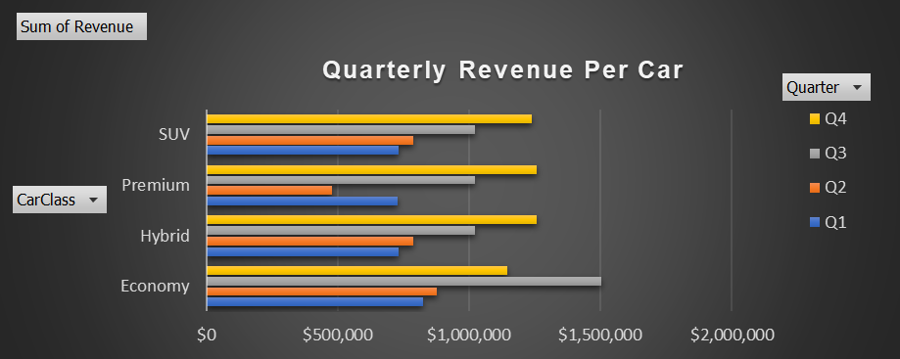
Car rental revenue in 2016
On the left we have the total income for each car class, based on the location that car was rented.
In the chart to the right we have the quarterly income for each car class.

Slide 4
And in conclusion
Findings
In the quarterly review for vehicle class we can clearly see that the Economy vehicle is the vehicle of choice to rent; we also see that rentals from the downtown area tend to be more profitable than the airport. The economy vehicle also had the highest amount of rented cars and most cars were rented from the downtown area.
Recommendation
Economy vehicles seem to be the safe and best option. If there is ever a place where a car is needed to be rented from the airport do not worry, airport rented vehicles had 4 thousand less vehicles rented for the 4-quarter cycle.

